Slide 1
区块链应用及 物联网
区块链之第一期： 比特币
持有、支付、挖掘比特币原理及协议
Andy Wu (吴增德）
Index
Notes:
Own, Send, Mine bitcoins
Public –Private Key Encryption
Question:
How the bitcoin is transferred, How the bitcoin is flowed
Bitcoin core code analysis
BitCoin Addresses:
Generate public / private key pair
Hash the public key → Bitcoin address
Guard the private key with your life
build an entire core banking platform on some form of distributed ledger technology.
One thing EWF potentially will work on, for example, is a unified blockchain platform
blockchain represents a real breakthrough when it comes to verifying "tiny little contracts in a point-to-point realm.“
sees blockchain as a breakthrough for traceability

Slide 2



区块链演化史
1.0
3.0
电子现金
去中心化交易
2.0
去中心化互联网、 去中心化社会治理
智能合约、数字资产、
物联网、各行业应用

Slide 3
国内外比特币新闻
全球多数据国家用比特币交易合法
迪拜计划成为世界首个区块链国家
日本 - 比特币正式成为一种合法的支付方式（2017.4）
菲律宾 - 承认比特币为一种支付系统， 给予正式“金融地位”
阿联酋 – 年初下禁令，一月后变更
俄罗斯 - 比特币没有威胁，比特币禁令无限期搁置
俄罗斯央行拟打造国家虚拟货币：要优于比特币
全球最大比特币交易所正进行融资 估值达10亿美元
央行区块链的数字票据交易平台测试成功
意义重大! 中国央行数字货币研究所即将挂牌
世界七成比特币产自中国 每枚电费成本达上万元
8年暴涨300万倍 风口上的比特币价值几何
比特币的红与黑：技术理念先进 价格暴涨暴跌引发担忧
比特币在国内三大交易平台成交超过80%
2017年5月份国内比特币交易成交额217.08亿元
Index

Slide 4
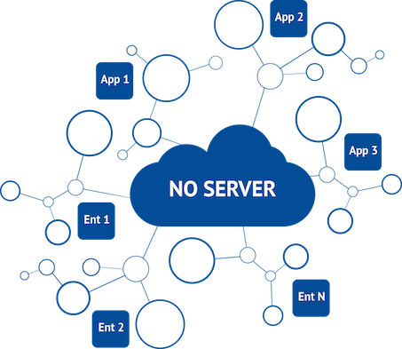
Introduction
Ledger
Alice → Bob | 5.4
Bob → Cindy | 100
Frank → Gary | 700
Carl → Dave | 0.001
… | …
What is blockchain?
What are transactions?
transfer of money! Alice → Bob 5 BTC
Where are they keeps?
In the ledger!
Where are user’s bitcoins come from?
From transactions!
Where is the ledger stored?
In the blockchain that every node maintains!
Index
Notes:
World's first decentralized Cryptocurrency
Invented in 2009 by Satoshi Nakamoto (中本聪)
No bank or central authority
Distributed consensus system
How transaction is done
How to transfer
RSA
Bitcoin cryptography
HASH 256
To understand: blockchain.info
Youtube: blockchain.info

Slide 5
Introduction
Ledger
Alice → Bob | 5.4
Bob → Cindy | 100
Frank → Gary | 700
Carl → Dave | 0.001
… | …
What is blockchain?
How is Block created?
Index
Notes:
World's first decentralized Cryptocurrency
Invented in 2009 by Satoshi Nakamoto (中本聪)
No bank or central authority
Distributed consensus system
How transaction is done
How to transfer
RSA
Bitcoin cryptography
HASH 256
To understand: blockchain.info
Youtube: blockchain.info

Slide 6
Outline
Cryptography Basics >>
Mining Blocks & Blockchain >>
Transactions >>
Blockchain application
Summary
Abbr. （简称）
BTC = bitcoin (比特币)
txn = transaction (交易)
sig = signature (数字签名)
blockchain (区块链)
ledger (账本)
Blockchain Viewer: Block, txn, tree
Bitcoin Requirement:
Anonymity
No double spending
Not able to crack in practice
Transaction security
Not able to be controlled by anybody
Index

Slide 7
Cryptographic Basics - Digital Signatures
Alice
Input Msg
Hash of input
Encrypt hash with private key
Msg, Sig, PubKey
Create
Verify
Bob
Signature = create(message, private key)
1=? verify(message, public key, signature)
1 =? V(msg, sig, pubKey)
Transaction
493830493 493168268 …
Transaction
493830493 493178268 …
Transaction
493830493 493178268 …
Digital Signature Math in Bitcoin
ecdsa (elliptic curve digital signature algorithm)
”mathematical trap door”
Dig Signature
Dig Signature
Dig Signature

Slide 8
Cryptographic Basics - Asymmetric encryption
Public Key Encryption
Lock sensitive msg with public key, unlock with private key
Digital Signatures
3rd party verify (via public key) that send by owner (private key)
Alice
Public key (k1)
Input (plaintext)
Encrypt
Output (ciphertext)
Bob
Encrypt
Plaintext (same as input)
Private key (k2)
Hash of input
Doc
Sig
PubKey
Alice
Input doc
Encrypt hash with private key
1 =? V(doc, sig, pubKey)
Bob

Slide 9
Cryptographic Basic – Large Numbers
Find a particular 256 bit (32 byte) number
Enumerate all numbers (finite) @ 1 billion/sec (1GHz)
2³⁰ | billion = giga 10^9 1,073,741,824 | 1 sec
2⁴⁰ | trillion = tera 10^12 1,099,511,627,776 | 18 mins
2⁵⁰ | 1,125,899,906,842,620 | 13 days
2⁶⁰ | 1,152,921,504,606,850,000 | 36 years
2⁹⁰ | 1*10^27 | 39 billion years
2¹²⁸ | 3*10^38 | 10 million-trillion years
2²⁵⁶ | 1*10^77 | 3*10^60 years
Total Number of Atoms on Earth: 2^160

Slide 10
Cryptographic Basics - Hash
Nonce: A large (>128 bit) random number. No two nonces are equal
Cryptographic Hash
Not two inputs produce the same output hash!
If you know the input, you can easily compute the hash
You cannot find ANY input that produces a particular hash
Hash Function
Input Data Bits, large number
256
bit hash

Slide 11
Cryptographic Introduction
Asymmetric encryption
Large Numbers
Hash

Slide 12
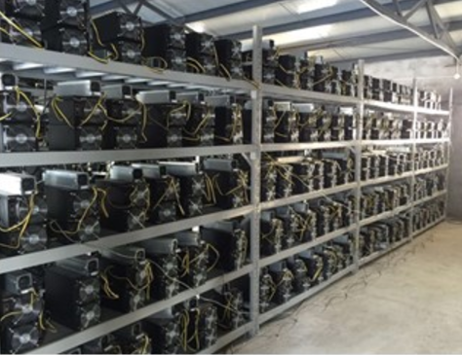
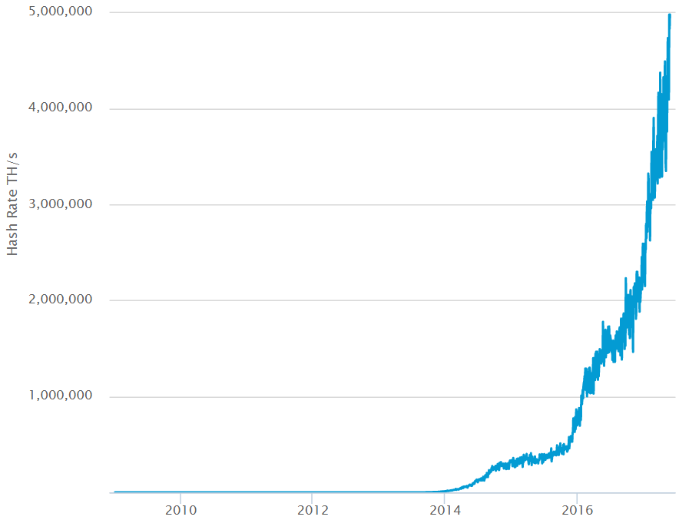
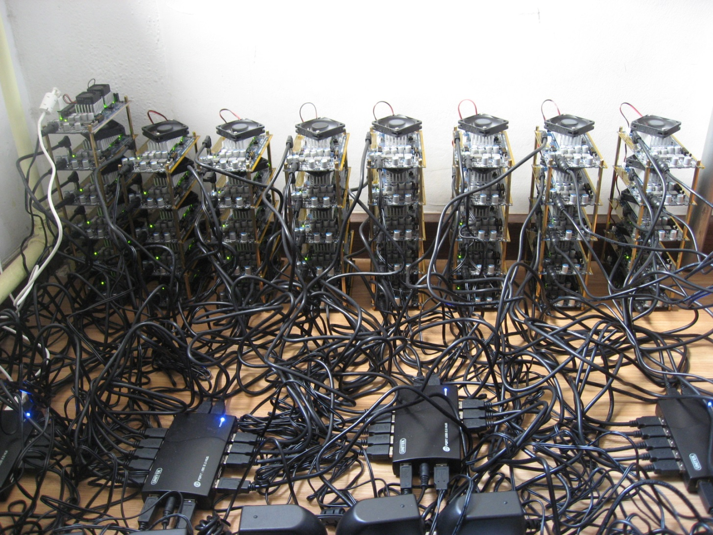
Mining
CPU
GPU
ASIC
Links

Slide 13

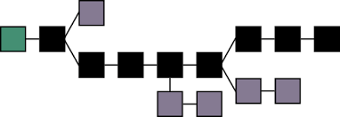
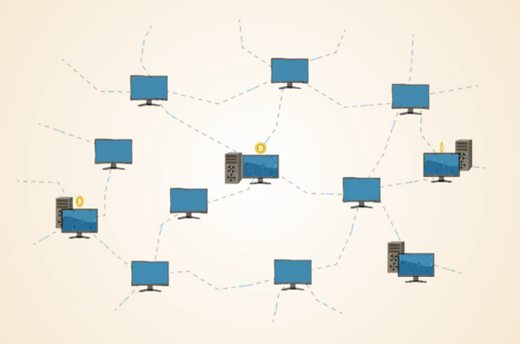


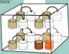
Mining
#0
#1
#2
#3
#4
#5
#38976
#38977
#38978
挖矿是一场竞赛，通常全网只有一个胜出者！
新挖出来的区块向全网广播

Slide 14
Blockchain
Miner machine keeps unconfirmed transactions
Mining process
Construct block, fill in unconfirmed transactions
txnHash = SHA256(transactions) :
0x 155c4f360……d2155c038264470eb71cdab81
blockID = SHA256(prev ID, txnHash, random number) : 0x 4470eb71……cdabc3d2155cb81f360385ac26
blockID < target difficulty → Target: 0x 00000000……0000a1b7e0eb71cda55c4f70eb7
Award & Fees
Every 4 years, award cut in half,
Start from 50 BTC / block
Current: 12.5 coins, + transaction fees
Future: no award, depend on transactions
all 21 million in 2140, Current 16.3 million
System control one block every 10 minutes
Adjust difficulty every 2016 blocks
To calculate
const
const
variable

Slide 15
Blockchain – Longest Chain Competition
Longest Chain Competition

Slide 16
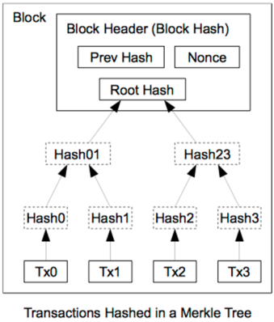
Block Header Hash Relations
Name | Byte Size | Description
Version (V) | 4 | Block Version Number.
Pre Hash (P_{h}) | 32 | This is the hash of the previous block header.
Merkle Root (H_{t}) | 32 | The hash based on all the transactions
Time (T) | 4 | Current Timestamp in seconds. unix fmt.
Target | 4 | Target value in compact form.
Nonce (R) | 4 | User adjusted value starting from 0

Slide 17
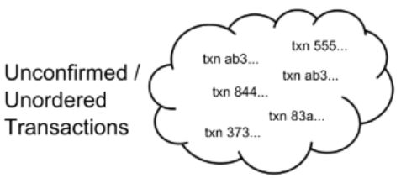
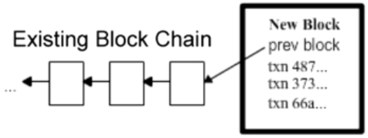
Blockchain with transaction
The Block Chain: Ordering Solution
Transactions: History of Ownership
Confirmed Transactions → added to blockchain
Unconfirmed Transactions → to add to blockchain

Slide 18
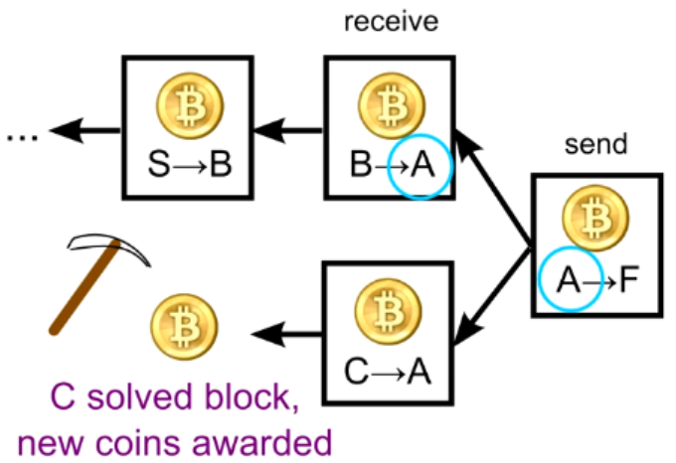
Blockchain info
Mining:
Create block every 10 minutes
Adjust difficulty every 2016 blocks, (around 2 weeks)
Every 4 years, award cut in half,
Start from 50 BTC / block
Current: 12.5 coins,
Future: no award, depend on transactions
all 21 million in 2140, Current 16.3 million
Smallest transaction unit: 1/10^8 BTC = 1 Satoshi
Real purpose:
Verify transactions
Safeguard the blockchain

Slide 19
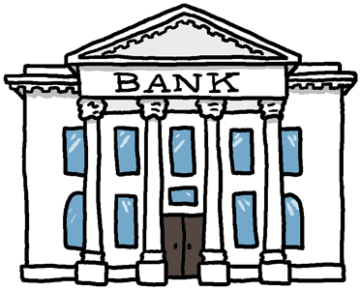
Transactions
Ledger
____ ____
____ ____
____
Ledger
____ ____
____ ____
____
Ledger
____ ____
____ ____
____
Ledger
____ ____
____ ____
____
Ledger
____ ____
____ ____
____
Ledger
____ ____
____ ____
____

Slide 20
Transactions
Ledger
____ ____
____ ____
____
Ledger
____ ____
____ ____
____
Ledger
____ ____
____ ____
____
Alice → Bob 5 BTC
Ledger
Alice 25
Bob 10
____ ____
20
15
Ledger
____ ____
____ ____
____
Ledger
Alice 25
Bob 10
____ ____
20
15
Ledger
____ ____
____ ____
____
Ledger
____ ____
____ ____
____
Ledger
Alice 25
Bob 10
____ ____
20
15
A→B
5 BTC
A→B
5 BTC
A→B
5 BTC
Passing other’s transactions along
A→B
5 BTC
Alice → Bob 5 BTC
June → Kaven 8 BTC
Sam → Tayler 8 BTC
… …

Slide 21
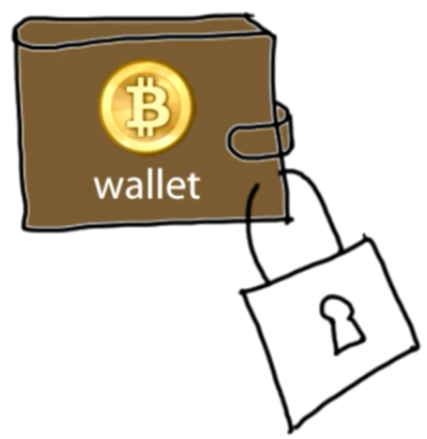
Authentication
Cryptographic Basics
Transaction Messages
Digital Signature
Alice → Bob 5 BTC d302721…
June → Dave 8 BTC 81758de…
Andy → Juan 6 BTC 17512c8…
Sam → John 4 BTC 9eac123…
? Alice ?
Digital Signature
Bf853d30272138df448817512c8de9cc3f75849eac1234cc …
different every time
How Can We know how much alice have ?
Create
Verify
Signature = create(message, private key)
1=? Verify(message, public key, signature)

Slide 22
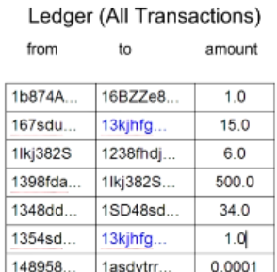
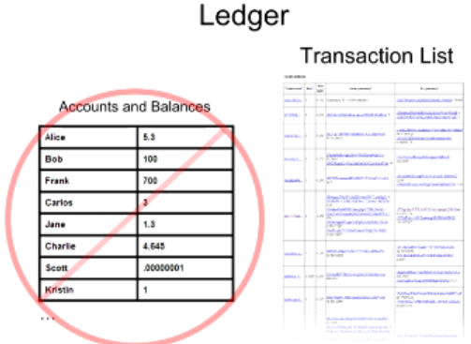
Balance Calculation
Balance: 16
22

Slide 23
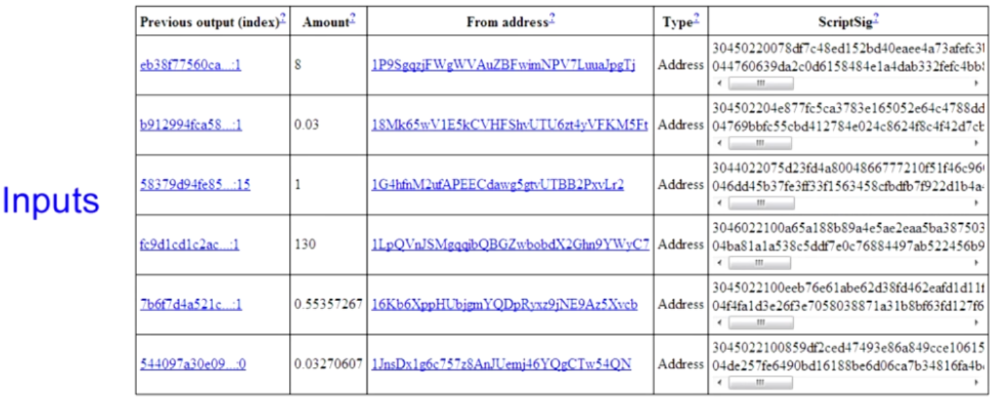
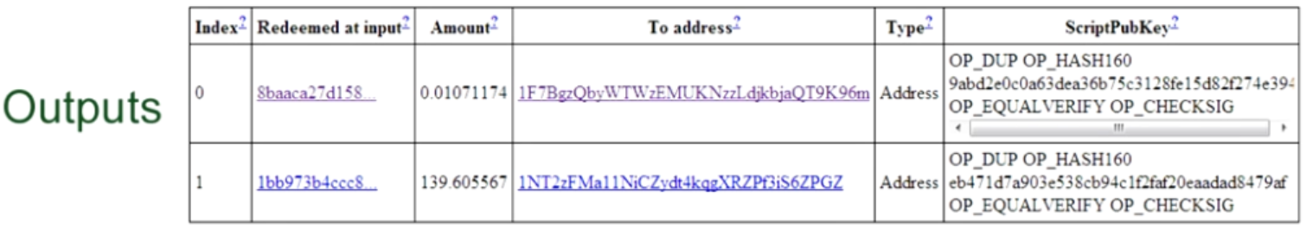
Real Transactions
Alice → Bob: 139.606 BTC
Ledger
______ ______
______ ______
Ledger
______ ______
______ ______
A→B
139 BTC
A→B
139 BTC
Ledger
______ ______
______ ______
= 139.616
A→B
139 BTC
back to sender
0.011
139.606
Added One more txn record in the next Block
But How?
23

Slide 24
Transaction Types
一对一（无找零）
一对一（有找零）
Output 0
“To 小红”
Input 0
“来自于小明，
被小明签名“
Input 0
“来自于小明，
被小明签名“
Output 0
“To 小红”
Output 1
“To 小明”
（找零）
组合交易（多对一）
分配交易（一对多）
Input 0
Output 0
Input 1
Output 1
Output 0
Input 0
Input 2
Output 2
Input n
Output n
24
24

Slide 25
Transactions in more detail
Input
Original Message
An ECDSA hash (Signature)
A public key
Output contains
Amount: being sent to the recipient.
Voluntary transaction fee
Change: being sent back to the original sender
Create
Verify
Notes:
Block chain
prevents the double spend attack
by giving other nodes the power to verify that transaction inputs were not already spent somewhere else.

Slide 26
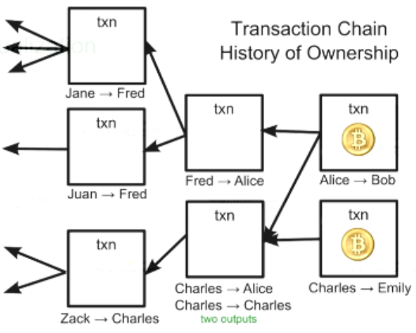
Transaction and Ledger
Bitcoins comes from chains of transactions
Check & index all transactions first time run mining
1 week download
~24 hours index
Why check & index all transactions in blockchain ?
26
26
Notes:
?? How the process pay 1.2, 2.5, 3.4

Slide 27
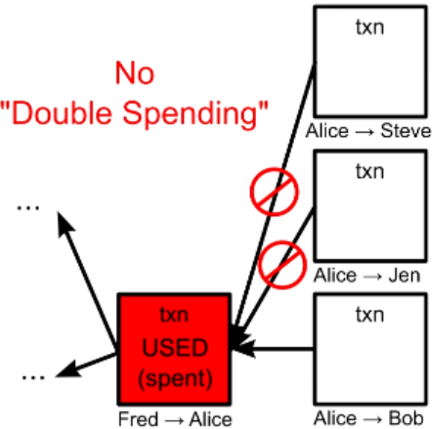
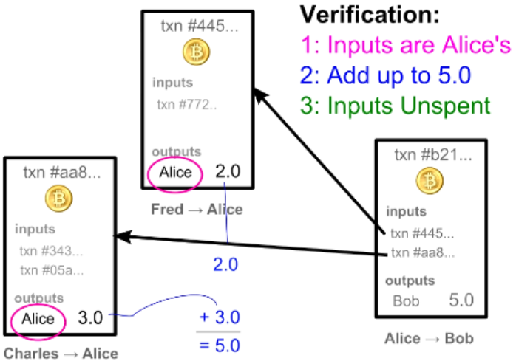
Transaction Verification
Each node verify block & txn before broadcast
Each txn Can Only be Used Once as an input
Recap: Blockchain & transaction
Blockchain.info
How the User info is kept in blockchain?
27
27

Slide 28
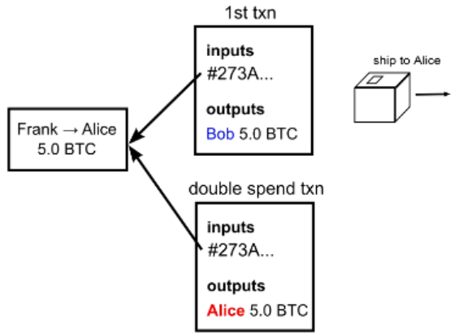
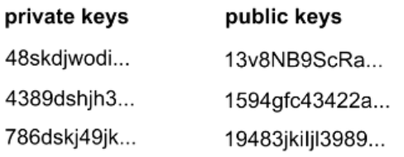
User info & Security
Anonymity: bitcoin address: 2^160
Bitcoin transaction Security:
Digital Signatures
Referenced Transactions
Nodes need to agree on transaction order
Security Hole: Transaction Order
Double Spending Fraud
Wallet

Slide 29
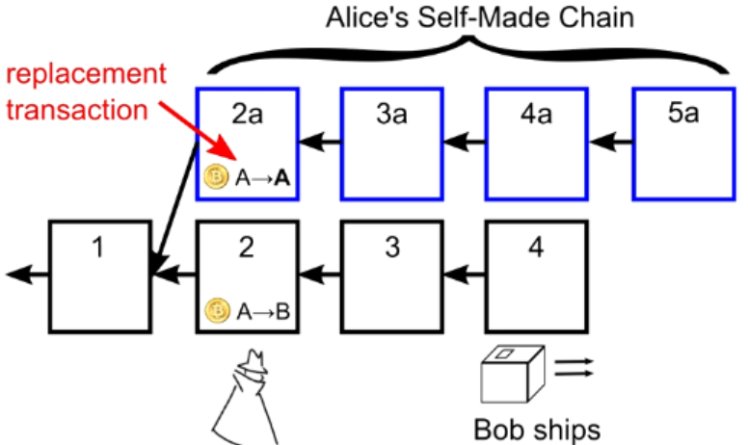
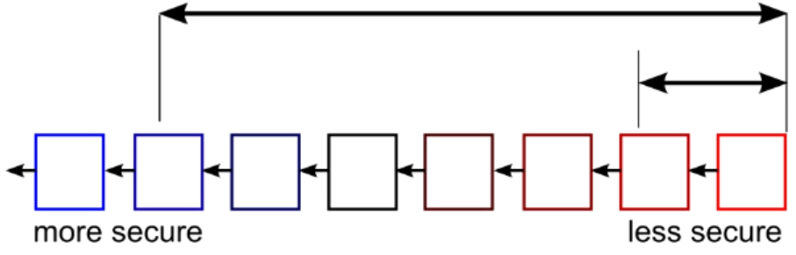
Double Spending Prevention
Wait for several block for safety

Slide 30
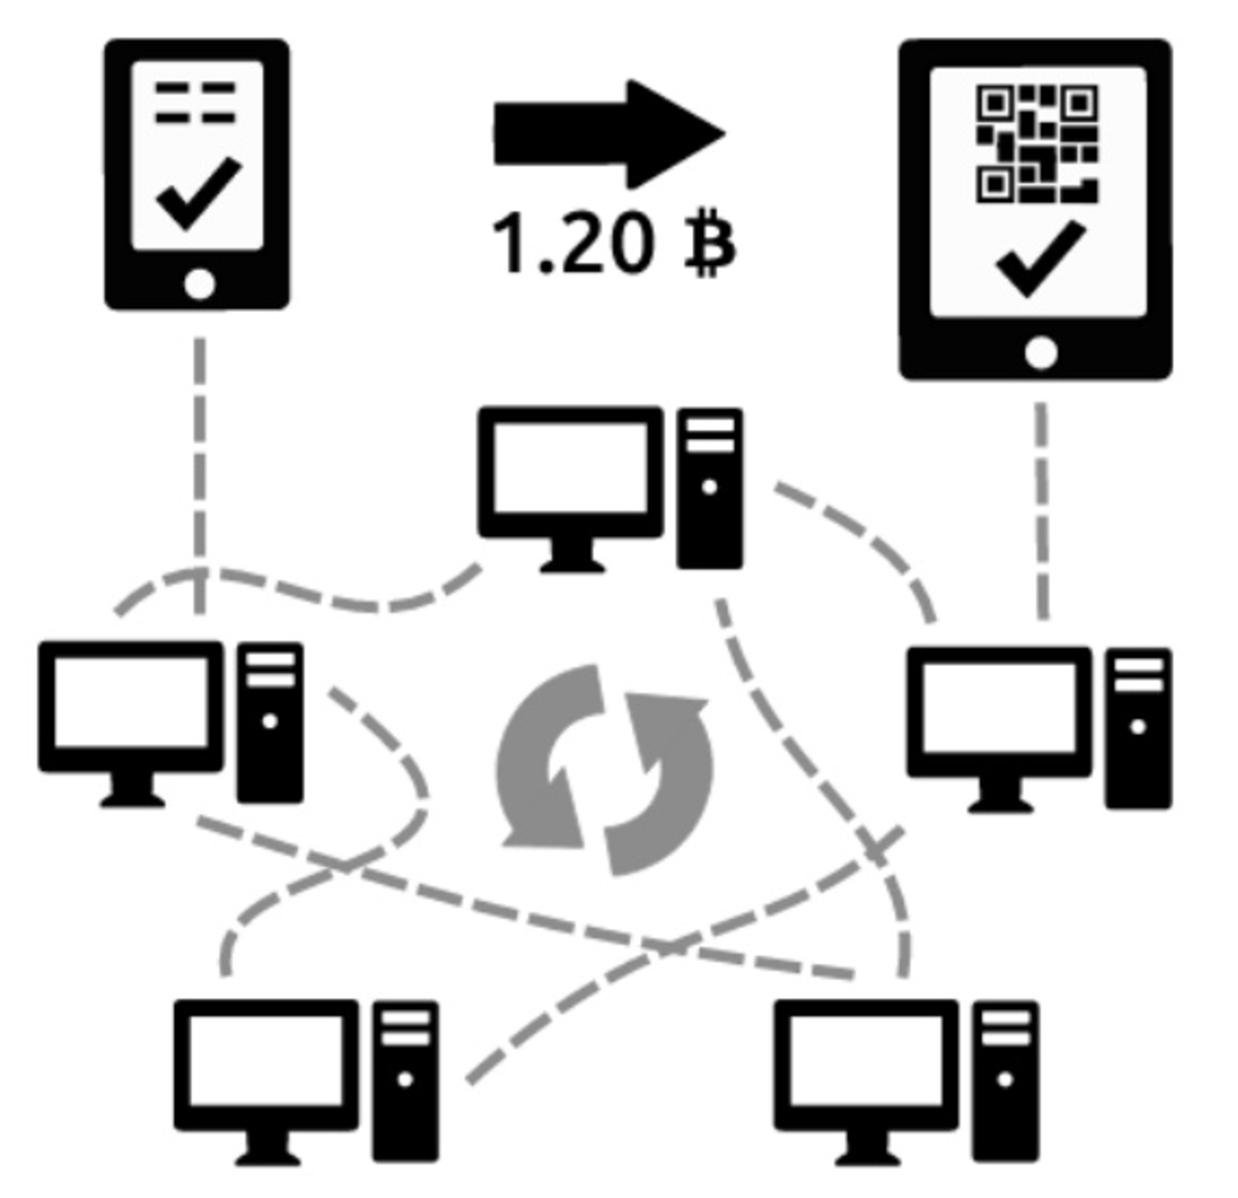
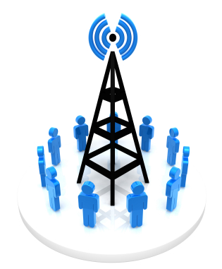
Recap
Blockchain:
block linked to a pre block → blockchain formed
Block Chain Orders Transactions
Transactions Chain transfers Ownership
How the Bitcoin network runs
New transactions are broadcasted to all users
Minters find the solution to the proof of work of the block
creates new block with Txn & broadcasted to all users
Each user accepts the received block if valid
existing blocks
new block
Time

Slide 31
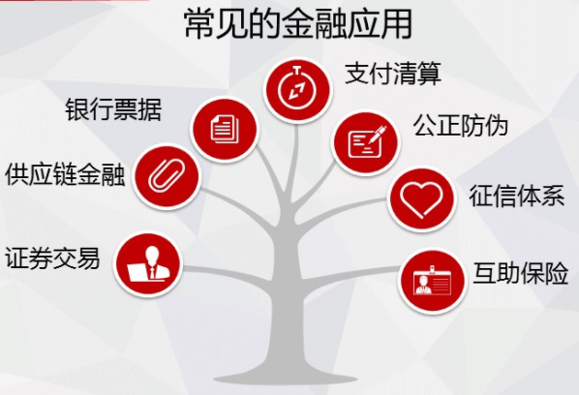
区块链应用
物联网应用
食品安全: 沃尔玛猪肉安全
去中心化租房
基于区块链的智慧消防
消防设备出厂
上报消防数据
火警设备数据
出警设备数据
消防建筑装修数据
…
Notes:
猪肉也用区块链技术： http://www.sohu.com/a/121532565_236263

Slide 32
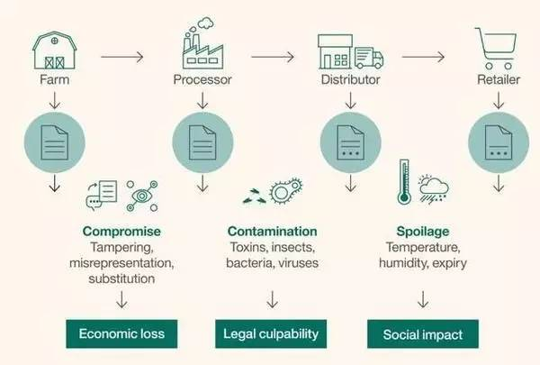
农产品出厂全过程

Slide 33
Specific Applications
Smart Renting: air Bnb
Food safety: pork traceability
IBM Walmart, Tsinghua Univ.
Certification Transparent
Notarization: public trust
Uber-less transportation
验证学位信息
百度金融也发行了基于区块链技术支持的ABS（资产证券化）项目
在微信黄金红包中已开始应用区块链技术进行数字资产的并行记账
Public blockchain
Private Blockchain
42 Banks alliance: R3CEV
Alliance blockchain
Notes:
Blockchain can transparently track the provenance of goods as they are passed from one organization to the next, building awareness and trust.
it supports an open source project called Hyperledger
One of the biggest philosophical o
obstacles is trust: Companies must get comfortable with the idea that their supply chain data won’t "live" in a central location.
终于把区块链的技术与应用讲清楚了: http://www.sohu.com/a/115881554_481636

Slide 34
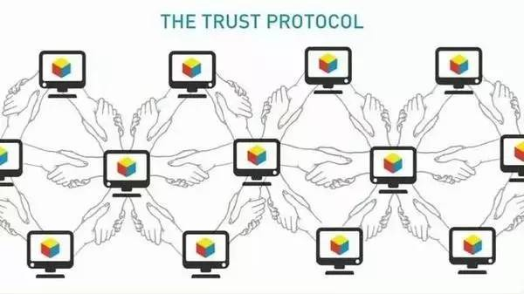
比特币（区块键1.0）小结
特点
独立性
不可重复支付
匿名
不可伪造性
去中心化
可传递性
可分性
公开透明
交易可追溯
局限性
交易确认时间长（平均10分钟）
交易吞吐量低
挖矿耗费大量机时和电力
分布式账本占用大量存储空间（~60GB）
经常性非法应用
任何政府和组织难以控制
安全、高效

Slide 35
Summery
Benefits
Government can’t print money or manipulate currency
Anonymity
Lower global transaction costs
Challenges
Difficult to exchange
Used for illegal activity (Government can’t track
Mining, or solving blocks use large amount of energy
Mathematically protected digital currency
Maintained by a network of peers
Digital Signature:
Safeguard money
Transaction chains
Store history of ownership
Block Chain
Hold transaction order

Slide 36
Q & A
Index

Slide 37
References
How do bitcoin transactions work
The Challenges of Block Chain Indexing
Blockchain platform evolution
IOTA: A Cryptoplatform for Securing Transactions on the IoT
Why IBM sees blockchain as a breakthrough for traceability
Index

Slide 38
Recap: Blockchain with transaction
Longest Chain Competition
38

